Slide 1
Concepts of Design Patterns

Slide 2
Background
Design patterns are optimized, reusable solutions to the programming problems that we encounter every day.
A design pattern is not a class or a library that we can simply plug into our system; it’s much more than that.
It is a template that has to be implemented in the correct situation.

Slide 3
Finding Objects
The hardest problems in object-oriented system development are:
  Identifying objects
  Decomposing the system into objects
Requirements Analysis focuses on application domain:
  Object identification
System Design addresses both, application and implementation domain:
  Subsystem Identification
Object Design focuses on implementation domain:
  Additional solution objects

Slide 4
Techniques for Finding Objects
Requirements Analysis
  Start with Use Cases. Identify participating objects
  Textual analysis of flow of events (find nouns, verbs, ...)
  Extract application domain objects by interviewing client (application domain knowledge)
  Find objects by using general knowledge
  Extract objects from Use Case scenarios (dynamic model)
System Design
  Subsystem decomposition
  Try to identify layers and partitions
Object Design
  Find additional objects by applying implementation domain knowledge

Slide 5
Another Source for Finding Objects : Design Patterns
Design Patterns are:
  The recurring aspects of designs are called design patterns [Gamma et al 1995].
  A pattern is the outline of a reusable solution to a general problem encountered in a particular context.
  It describes the core of the solution to that problem, in such a way that you can use this solution a million times over, without ever doing it the same twice. Many of them have been systematically documented for all software developers to use.

Slide 6
What is a Pattern?
Current use comes from the work of the architect Christopher Alexander.
Alexander studied ways to improve the process of designing buildings and urban areas.
“Each pattern is a three-part rule, which expresses a relation between a certain context, a problem and a solution.”
Hence, the common definition of a pattern: “A solution to a problem in a context.”
Patterns facilitate reuse of successful software architectures and designs.
Each pattern describes a problem which occurs over and over again in our environment, and then describes the core of the solution to that problem, in such a way that you can use this solution a million times over, without ever doing it the same way twice.

Slide 7
Why Patterns?
"Designing object-oriented software is hard and designing reusable object-oriented software is even harder." - Erich Gamma.
Experienced designers reuse solutions that have worked in the past.
Well-structured object-oriented systems have recurring patterns of classes and objects.
Knowledge of the patterns that have worked in the past allows a designer to be more productive and the resulting designs to be more flexible and reusable.

Slide 8
Software Patterns History
1987 - Cunningham and Beck used Alexander’s ideas to develop a small pattern language for Smalltalk
1990 - The Gang of Four (Gamma, Helm, Johnson and Vlissides) begin work compiling a catalog of design patterns
1991 - Bruce Anderson gives first Patterns Workshop at OOPSLA
1993 - Kent Beck and Grady Booch sponsor the first meeting of what is now known as the Hillside Group
1994 - First Pattern Languages of Programs (PLoP) conference
1995 - The Gang of Four (GoF) publish the Design Patterns boo

Slide 9
Types of Software Patterns
Analysis
Design
Organizational
Process
Project Planning
Configuration Management

Slide 10
Design Pattern Levels of Abstraction
Complex design for an entire application or subsystem
Solution to a general design problem in a particular context
Simple reusable design class such as a linked list, hash table, etc.

Slide 11
GoF Design Patterns
The GoF design patterns are in the middle of these levels of abstraction
“A design pattern names, abstracts, and identifies key aspects of a common design structure that makes it useful for creating a reusable object-oriented design.”
The GoF design patterns are “descriptions of communicating objects and classes that are customized to solve a general design problem in a particular context.”

Slide 12
Elements of Design Patterns
Design patterns have four essential elements:
  Pattern name
  Problem
  Solution
  Consequences

Slide 13
Pattern Name
A handle used to describe:
  a design problem
  its solutions
  its consequences
Increases design vocabulary
Makes it possible to design at a higher level of abstraction
Enhances communication
“The Hardest part of programming is coming up with good variable [function, and type] names.”

Slide 14
Problem
Describes when to apply the pattern
Explains the problem and its context
May describe specific design problems and/or object structures
May contain a list of preconditions that must be met before it makes sense to apply the pattern

Slide 15
Solution
Describes the elements that make up the
  design
  relationships
  responsibilities
  collaborations
Does not describe specific concrete implementation
Abstract description of design problems and how the pattern solves it

Slide 16
Consequences
Results and trade-offs of applying the pattern
Critical for:
  evaluating design alternatives
  understanding costs
  understanding benefits of applying the pattern
Includes the impacts of a pattern on a system’s:
  flexibility
  extensibility
  portability

Slide 17
Design Patterns are NOT
Designs that can be encoded in classes and reused as is (i.e., linked lists, hash tables)
Complex domain-specific designs (for an entire application or subsystem)
They are:
  “Descriptions of communicating objects and classes that are customized to solve a general design problem in a particular context.”

Slide 18
Where They are Used
Object-Oriented programming languages [and paradigm] are more amenable to implementing design patterns
Procedural languages: need to define
  Inheritance
  Polymorphism
  Encapsulation

Slide 19
Design Patterns
Describe a recurring design structure
  Defines a common vocabulary
  Abstracts from concrete designs
  Identifies classes, collaborations, and responsibilities
  Describes applicability, trade-offs, and consequences

Slide 20
Design Pattern Descriptions (Template)
Name and Classification: Essence of pattern
Intent: What it does, its rationale, its context
AKA: Other well-known names
Motivation: Scenario illustrates a design problem
Applicability: Situations where pattern can be applied
Structure: Class and interaction diagrams
Participants: Objects/classes and their responsibilities
Collaborations: How participants collaborate
Consequences: Trade-offs and results
Implementation: Pitfalls, hints, techniques, etc.
Sample Code
Known Uses: Examples of pattern in real systems
Related Patterns: Closely related patterns

Slide 21
Example: Observer Pattern
Intent
  Define a one-to-many dependency between objects so that when one object changes state, all its dependents are notified and updated automatically
Also Known As
  Dependents, Publish-Subscribe, Model-View

Slide 22
Design Patterns in Smalltalk MVC
The Model/View/Controller (MVC) triad of classes is used to build user interfaces in Smalltalk-80. MVC consists of three kinds of objects:
Model is the application object,
View is its screen presentation,
Controller defines the way the user interface reacts to user input.

Slide 23
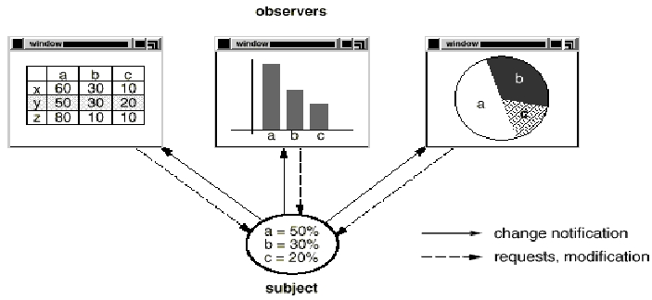
  Motivation
    The need to maintain consistency between related objects without making classes tightly coupled.
    MVC decouples them to increase flexibility and reuse.

Slide 24
Applicability
Use the observer pattern in any of the following situations:
When an abstraction has two aspects, one dependent on the other. encapsulating these aspects in separate objects lets you vary and reuse them independently.
When a change to one object requires changing others
When an object should be able to notify other objects without making assumptions about those objects

Slide 25
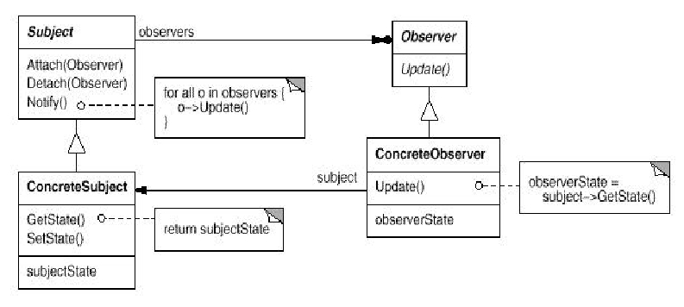
Structure

Slide 26
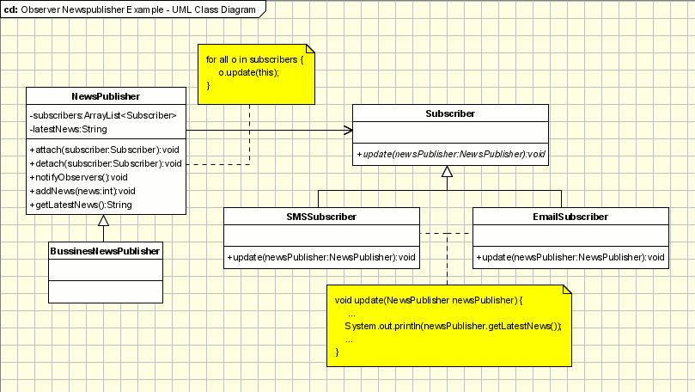
Example - News Agency

Slide 27
Example - News Agency
A news agency gather news news and publish them to different subscribers. We need to create a framework for and agency to be able to inform immediately, when event occurs, its subscribers about the event. The subscribers can receive the news in different ways: Emails, SMS, ...
Obviously, the agency is represented by an Observable(Subject) class named NewsPublisher. The concrete class is BusinessNewsPublisher.
The observer logic is implemented in NewsPublisher. It keeps a list of all it subscribers and it informs them about the latest news. The subscribers are represented by some observers (SMSSubscriber, EmailSubscriber). Both the observers mentioned above are inherited from the Subscriber. The subscriber is the abstract class which is known to the publisher.
In the main class a publisher(Observable) is built and a few subscribers(Observers). The subscribers are subscribed to the publisher and they can be unsubscribed. In this architecture new types of subscribers can be easily added(instant messaging, ...) and new types of publishers(Weather News, Sport News, ...).

Slide 28
Participants
  Subject
    Keeps track of its observers
    Provides an interface for attaching and detaching Observer objects
  Observer
    Defines an interface for update notification
  ConcreteSubject
    The object being observed
    Stores state of interest to ConcreteObserver objects
    Sends a notification to its observers when its state changes
  ConcreteObserver
    The observing object
    Stores state that should stay consistent with the subject's
    Implements the Observer update interface to keep its state consistent with the subject's

Slide 29
Collaborations

Slide 30
Consequences
  Benefits
    Minimal coupling between the Subject and the Observer
      Can reuse subjects without reusing their observers and vice versa
      Observers can be added without modifying the subject
      All subject knows is its list of observers
      Subject does not need to know the concrete class of an observer, just that each observer implements the update interface
      Subject and observer can belong to different abstraction layers
    Support for event broadcasting
      Subject sends notification to all subscribed observers
      Observers can be added/removed at any time
  Liabilities
    Possible cascading of notifications
      Observers are not necessarily aware of each other and must be careful about triggering updates
    Simple update interface requires observers to deduce changed item

Slide 31
Implementation Issues
  How does the subject keep track of its observers?
    Array, linked list
  What if an observer wants to observe more than one subject?
    Have the subject tell the observer who it is via the update interface
  Who triggers the update?
    The subject whenever its state changes
    The observers after they cause one or more state changes
    Some third party object(s)
  Make sure the subject updates its state before sending out notifications
  How much info about the change should the subject send to the observers?
    Push Model - Lots
    Pull Model - Very Little

Slide 32
Implementation Issues
  Can the observers subscribe to specific events of interest?
    If so, it's publish-subscribe
  Can an observer also be a subject?
    Yes!
  What if an observer wants to be notified only after several subjects have changed state?
  Use an intermediary object which acts as a mediator
  Subjects send notifications to the mediator object which performs any necessary processing before notifying the observers

Slide 33
Sample Code: Java source code
Known Uses
  Smalltalk Model/View/Controller user interface framework
    Model = Subject
    View = Observer
    Controller is whatever object changes the state of the subject
  Java 1.1 AWT/Swing Event Model
Related Patterns
  Mediator
    To encapsulate complex update semantics

Slide 34
When to Use Patterns
Solutions to problems that recur with variations
  No need for reuse if problem only arises in one context
Solutions that require several steps:
  Not all problems need all steps
  Patterns can be overkill if solution is a simple linear set of instructions
Solutions where the solver is more interested in the existence of the solution than its complete derivation
  Patterns leave out too much to be useful to someone who really wants to understand
  They can be a temporary bridge

Slide 35
What Makes it a Pattern?
A Pattern must:
  Solve a problem and be useful
  Have a context and can describe where the solution can be used
  Recur in relevant situations
  Provide sufficient understanding to tailor the solution
  Have a name and be referenced consistently

Slide 36
Benefits of Design Patterns
Capture expertise and make it accessible to non-experts in a standard form
Facilitate communication among developers by providing a common language
Make it easier to reuse successful designs and avoid alternatives that diminish reusability
  Facilitate design modifications
  Improve design documentation
  Improve design understandability
Patterns explicitly capture expert knowledge and design tradeoffs and make it more widely available
Patterns help ease the transition to OO technology

Slide 37
Drawbacks to Design Patterns
Patterns do not lead to direct code reuse
Patterns are deceptively simple
Teams may suffer from pattern overload
Patterns are validated by experience and discussion rather than by automated testing
Integrating patterns into a software development process is a human-intensive activity.

Slide 38
Suggestions for Effective Use
Do not recast everything as a pattern
  Instead, develop strategic domain patterns and reuse existing tactical patterns
Institutionalize rewards for developing patterns
Directly involve pattern authors with application developers and domain experts
Clearly document when patterns apply and do not apply
Manage expectations carefully.

